Slide 1



Rare Global Food Trading Corp.
Team FONG

Slide 2
Problems Encountered by Client
ID N# | Description What is the problem? | Cause What causes the problem? | Symptoms How do we know the problem exists? | Impact Why is this important? What are the consequences?
1 | Upon monthly warehouse check there are items unaccounted for. | There are different databases for many information or records the company keeps. | The user manually checks and balances the databases. | Productivity is not maximized and time is wasted.
2 | Secretary is confused about the products and orders. | Manual inventory by using different excel files for orders, meats, and seafoods. | The secretary have different excel files for orders, meat, and seafood inventories. | This can lead to waste of time, mix ups, or confusions especially when large volumes of orders are made.

Slide 3
Problems Encountered by Client
The company cannot instantly see the total quantity of products to be delivered per day. | There is no function that will count the total requirement per product per day in their excel sheet. | The user gets confused when he/she manually counts the orders. | This might confuse the users especially when counting a large volume of orders. Also, there is a possibility that they can miscount orders thus, may affect credibility and customer relation of the company.

Slide 4
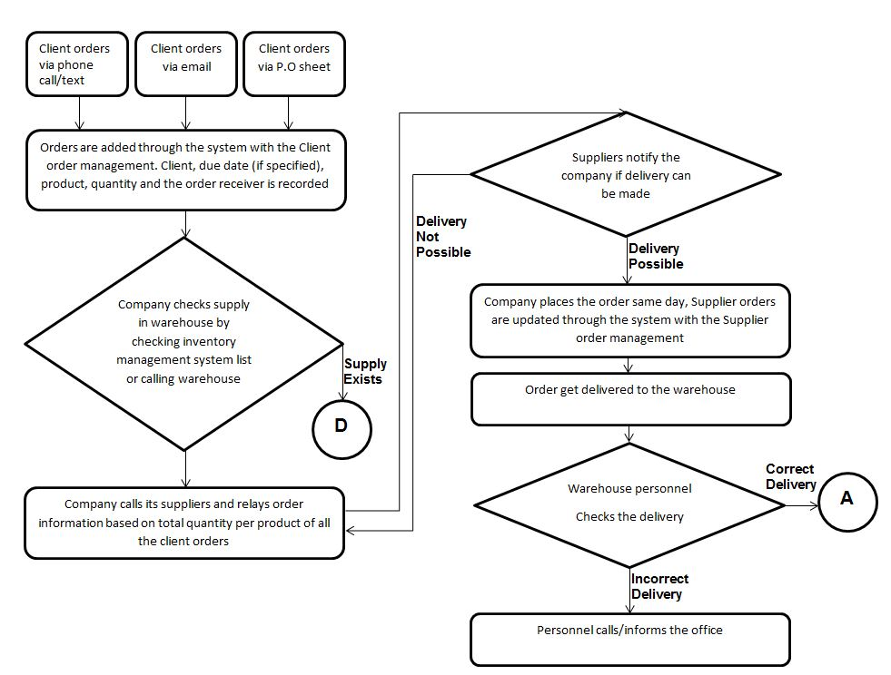
Improved Process Flow

Slide 5
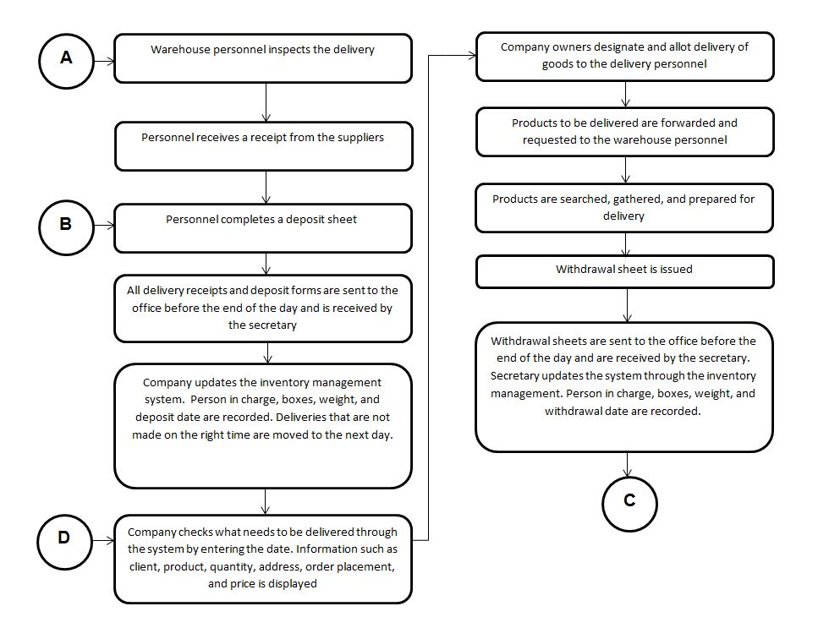
Improved Process Flow

Slide 6
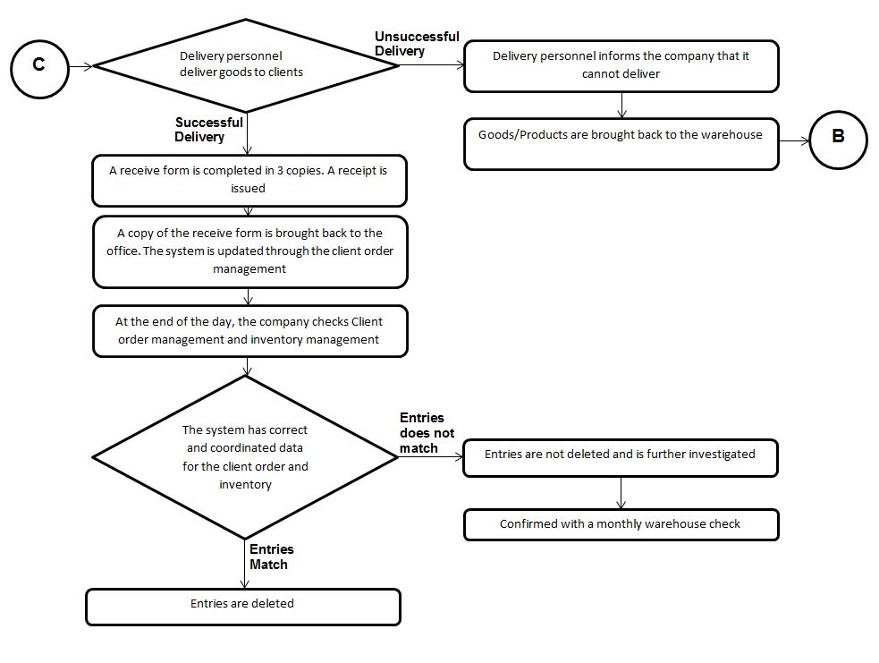
Improved Process Flow

Slide 7
Committed User Stories

Slide 8
User Story # 1
User Story #1: The administrative officers can add a new client order.
Estimate (Days): 2 days | Priority: 100
Pre-condition: Administrative officers receives a call, email, or PO about an order.
Scenario: The administrative officers select add new client order from the main menu. The system displays the add new client order page. The administrative officers input the client name. The administrative officers choose product name, enter quantity and price. The administrative officers click add product. The system adds the product to “cart”. The administrative officers can delete or modify the product in the cart by clicking the product in the cart. The administrative officers can add another product by choosing and entering product details by repeating scenario 4 and 5. The administrative officers enter order receiver, selects due date by month, day, and year, and inputs other notes. The administrative officers click submit.

Slide 9
User Story # 1
11. The system will ask the user to confirm the submission.
12. The administrative officers will confirm.
13. The system checks if the necessary fields are filled up and valid.
14. The system adds the new client order to the order management database and assigns order number to the new client order.
15. The system displays message that the order has been added.
Post-condition: The system reflects added order in the order management database.
Acceptance Criteria: Test if system does not accept invalid/empty inputs in client name, quantity, price, order receiver, and due date. Test if the quantity and price is greater than 0 and is a numerical value. Test if the administrative officers can add product to the cart, and modify and delete product from the cart. Test if new orders are reflected in the order management database. Verify if the system asks the user to confirm before submission. Verify that an error message is displayed when there is an invalid input. Verify that the system displays the message “A new client order has been added”, after the client order is added to the order management database.

Slide 10
User Story # 2
User Story #2: The administrative officers can view the total number of client orders of each product based on the delivery due date or client name.
Estimate (Days): 2 days | Priority: 100
Pre-condition:
Scenario: The administrative officers select view orders from the main menu. The system displays the view client orders page. The administrative officers will choose whether to filter the client orders by delivery due date or client name. If delivery due date is selected, the administrative officers will choose the delivery due date. If client name is selected, the administrative officers will input the client name. The administrative officers will click submit. If delivery due date is selected and submitted: 7.1 The system validates if there are any orders in the specified date. 7.2 The system adds all the orders of the same product and get its total. 7.3 The system displays order entries with matching delivery due date. 7.4 The system displays a summary at the bottom which contains the total orders of each product on the specified delivery due date.

Slide 11
User Story # 2
8. If client name is selected and submitted:
8.1 The system will check if the input is valid and not empty.
8.2 The system adds all the orders of the same product and get its total.
8.3 The system displays order entries with matching client name.
8.4 The system displays a summary at the bottom which contains the total orders of each product of the specified client name.
Post-condition:
Acceptance Criteria: Test if system does not accept invalid and empty inputs in client name if client name is selected. Test if system does not accept empty inputs in delivery due date if delivery due date is selected. Test if the administrative officers can see client orders in different views (delivery due date, client name), and can change views. Verify that an error message is displayed when there is an invalid or empty input. If there are client orders shown, check if it displays the correct orders and information. Verify if it displays the correct total quantity per product. Verify if the system displays the message “No client orders found” when there is no order in the order management database or there are no orders with matching delivery due date or client name.

Slide 12
User Story # 3
User Story #3: The administrative officers can view all, pending, or delivered client orders.
Estimate (Days): 2 Days | Priority: 80
Pre-condition:
Scenario: The administrative officers select view orders from the main menu. The system displays the view client orders page. The administrative officers will choose whether to view all, pending, or delivered client orders. If all is selected: 4.1 The system displays all client orders based on the time it was added to the database, starting from the latest. If pending is selected: 5.1 The system will check if there are any orders whose delivery status is pending. 5.2 The system displays pending client orders based on the time it was added to the database, starting from the latest. If delivered is selected: 6.1 The system will check if there are any orders whose delivery status is delivered or done. 6.2 The system displays delivered client orders based on the time it was added to the database, starting from the latest.

Slide 13
User Story # 3
Post-condition:
Acceptance Criteria: Test if the administrative officers can see the client orders in different views (all, pending, delivered), and can swap among the views. If there are client orders shown, check if it displays the correct orders and information. Verify if the system displays the message “No client orders found” when there is no order in the order management database or there are no orders in the ord with matching delivery status.

Slide 14
User Story # 7
User Story #7: The administrative officers can mark a client order as delivered.
Estimate (Days): 1 Day | Priority: 100
Pre-condition: The order is delivered.
Scenario: The administrative officers select view orders from the main menu. The system displays the view client orders page. The administrative officers choose to view pending orders. The system displays pending client orders and their details The administrative officers choose a pending client order. The administrative officers click done/delivered. The system verifies if the administrative officers will mark the client order as delivered. The administrative officers confirms. The system updates the delivery status of the client order to the order management database. The system displays that the client order is delivered.

Slide 15
User Story # 7
Post-condition: The change is reflected in the order management database.
Acceptance Criteria: Test if the change of delivery status of the client order is reflected in the order management database. Verify if the system displays the message “No client orders found”, if the order management database contains no pending client orders. Verify if the confirmation message appears after the administrative officers click done/delivered. Verify if the system displays the message “The client order is delivered.”, after the administrative officers confirm.

Slide 16
User Story # 8
User Story #8: The administrative officers will add new products to update the product list database.
Estimate (Days): 2 Days | Priority: 100
Pre-condition: There are new products that the company will offer to its clients
Scenario: The administrative officers select add a product from the main menu. The system displays the add a product page. The administrative officers enter product name. The administrative officers choose product type (seafood, meat), subtype (ribs, salmon) and enters product price per kilogram to the system. Additional fields depend on the product type. The administrative officers click submit. The system checks if the necessary fields are filled up and valid. If any of the input is invalid, the administrative officers are asked to input again until valid inputs are submitted. The system adds the new product to the product list database. The system displays message that the product has been added.

Slide 17
User Story # 8
Post-condition: The system reflects the added product in the product list database.
Acceptance Criteria: Test if the system does not accept invalid or empty inputs in product name, type, subtype, and price. Test if the product price are greater than 0 and is a numeric value. Test if the new products are reflected in the product list database. Verify that an error message is displayed when there is any empty or invalid input. Verify that the system displays the message “A new product has been added”, after the product is added to the product list database.

Slide 18
User Story # 12
User Story #12: The administrative officers will view all the products in the product list database.
Estimate (Days): 1 Day | Priority: 100
Pre-condition: There are products the product list database.
Scenario: The administrative officers select view products from the main menu. The system checks if there are any products in the product list database. The system displays all the products according to its type and description.
Post-condition:
Acceptance Criteria: Test if the products are sorted by type and alphabetically. Test if company is able to view the correct and updated product list database. Verify that the message “No product in database” is displayed when there is no product in the product list database.

Slide 19
Implementation Demo

Slide 20
Test Report Statistics

Slide 21
Problem Report # 1
Program: Add Client Order
Summary: Cart contains blank rows from previous order

Slide 22
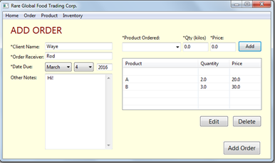
Problem Report # 1
Problem Report # 1
Fixed: Yes
Screenshot:

Slide 23
Problem Report # 2
Problem Report # 2
Program: Add Client Order
Summary: Order is added to database even if Client Name field is blank

Slide 24
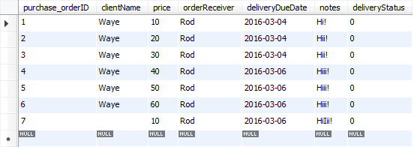
Problem Report # 2
Problem Report # 2
Fixed: Yes
Screenshot:

Slide 25
Problem Report # 3
Problem Report # 3
Program: Add Client Order
Summary: Order is added to database even if Order Receiver field is blank

Slide 26
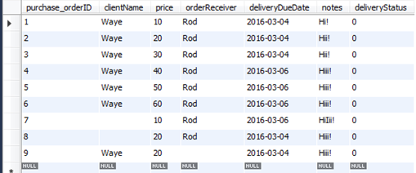
Problem Report # 3
Problem Report # 3
Fixed: Yes
Screenshot:

Slide 27
Problem Report # 4
Problem Report # 4
Program: Add Client Order
Summary: Order is accepted even if no month is selected for Due Date, but no data is added to the database
Fixed: Yes

Slide 28
Problem Report # 5
Problem Report # 5
Program: Add Client Order
Summary: Order is accepted even if no day is selected for Due Date, but no data is added to the database
Fixed: Yes

Slide 29
Problem Report # 6
Problem Report # 6
Program: Add Client Order
Summary: Nothing happens when year field is blank or entered with an invalid input

Slide 30
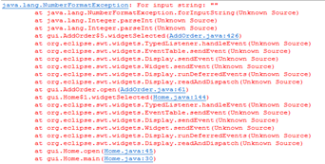
Problem Report # 6
Problem Report # 6
Fixed: Yes
Screenshot: Error displayed at the console

Slide 31
Problem Report # 7
Problem Report # 7
Program: View Client Order
Summary: Only the first product ordered by the client is shown when Client Name filter is selected

Slide 32
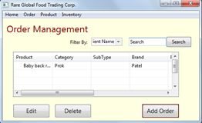
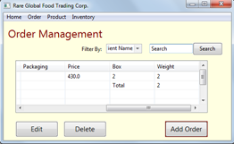
Problem Report # 7
Problem Report # 7
Fixed: Yes
Screenshot:

Slide 33
Problem Report # 8
Problem Report # 8
Program: View Client Order
Summary: Selecting a new filter will add the new filter’s output to the previous filter’s (display is not cleared)

Slide 34
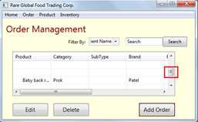
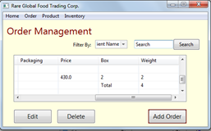
Problem Report # 8
Problem Report # 8
Fixed: Yes
Screenshot:

Slide 35
Problem Report # 9
Problem Report # 9
Program: View Client Order
Summary: Window/display is too small for convenient viewing
Fixed: Yes

Slide 36
Problem Report # 10
Problem Report # 10
Program: View Client Order
Summary: System does not show “No Pending Deliveries” when there are no pending orders
Fixed: Yes

Slide 37
Problem Report # 11
Problem Report # 11
Program: View Client Order
Summary: Marking more than one order as ‘delivered’ only sets the first marked item as delivered
Fixed: Yes

Slide 38
Problem Report # 12
Problem Report # 12
Program: View All Products
Summary: The system did not display a message stating that there were no products in the database
Fixed: Yes

Slide 39
Problem Report # 13
Problem Report # 13
Program: Add New Product
Summary: The system still adds the product even though some required fields are left empty
Fixed: Yes

Slide 40
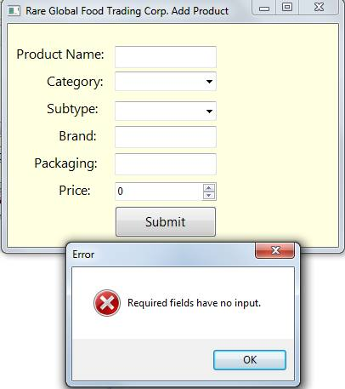
Problem Report #13
Problem Report # 13
Screenshot:

Slide 41
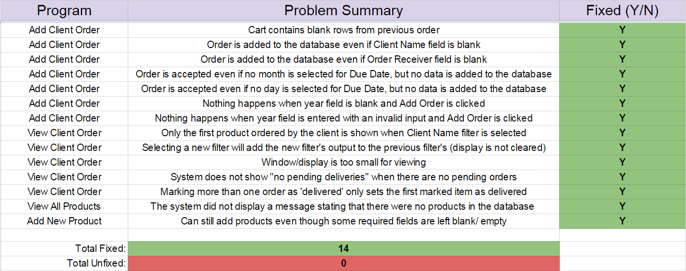
Problem Report Statistics Summary

Slide 42
Thank you for listening!

